Slide 1
Data 618: Brain Stumper4
Ramnivas Singh
MSDS CUNY - 2022

Slide 2
Summary :
Source monthly oil and motor fuel price data for a significant period (~ 30 years or longer) from a reputable source (E.g.: US Energy Information Administration - https://www.eia.gov/)
Source inflation rate (CPI and PPI) data from an authoritative source (E.g.: US Bureau of Labor Statistics - https://www.bls.gov/)
Determine and plot the correlation between energy costs and inflation and demonstrate its change over the period studied.
Provide an assessment of the causes for the changes.
Commit your analyses, code used, results and summary presentation in your personal repo and send me links to your work in response to this email.

Slide 3
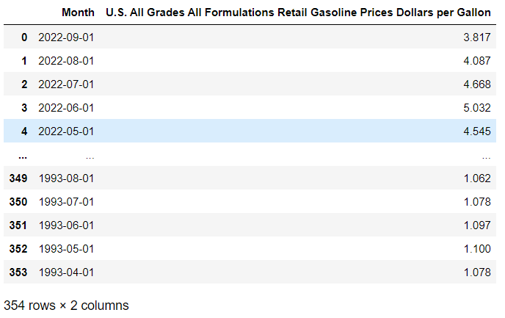
#1 : Source monthly price data
Monthly Gasoline Price Per Gallon data sourced from https://www.eia.gov/

Slide 4
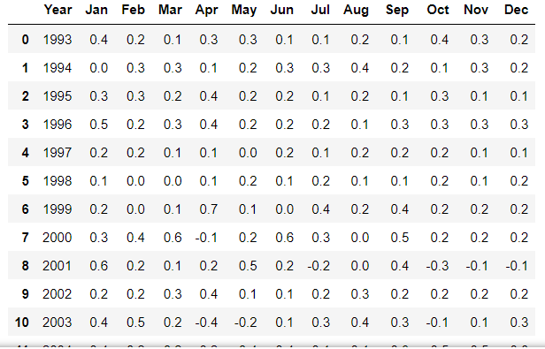
#2 : Source inflation rate data
Monthly Consumer Price Index Data sourced from https://www.bls.gov/

Slide 5
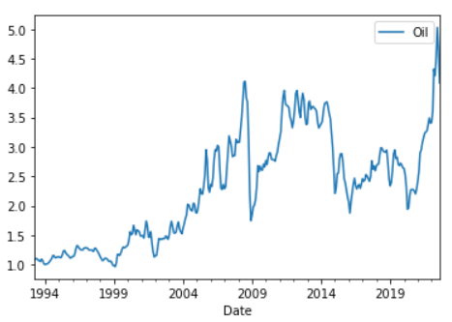
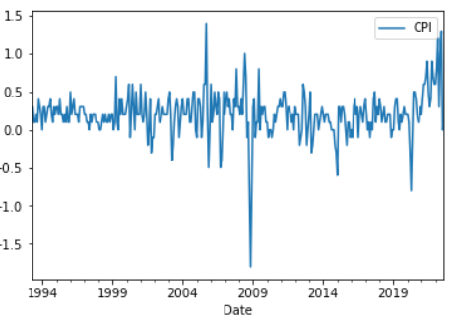
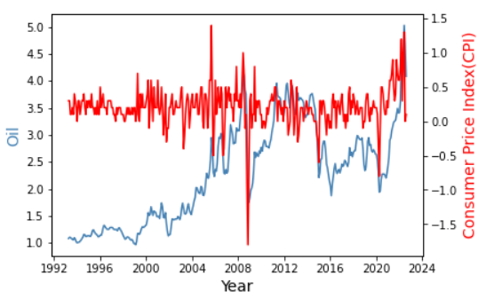
#3a :Correlation between energy costs and inflation (Gasoline - CPI)

Slide 6
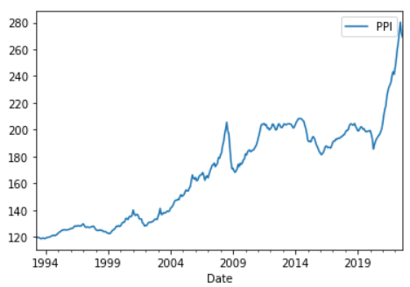
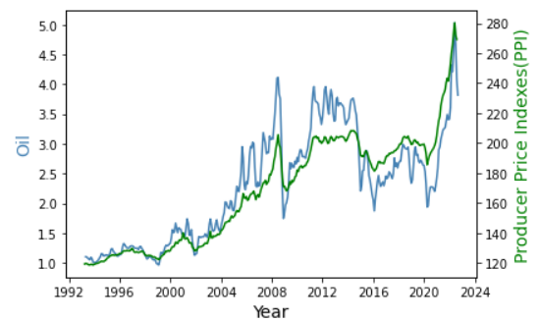
#3b :Correlation between energy costs and Producer Price Index (PPI vs Gasoline)

Slide 7
#4 : Causes for the changes
General trend of increasing oil prices are based on global economy strength, consumptions and production of the products
We see a pattern from 2009, 2015 and 2021 – when CPI goes down oil prices also goes down. This is the time of stressful housing market, equity market crash and Covid-19 triggered pandemic.
There is weaker relationship between oil prices and CPI inflation. The correlation is 0.154, much lower than for producer prices
The graph shows a strong positive relationship between oil prices and PPI inflation. That is, higher oil prices are associated with higher producer prices and vice versa.
The correlation between oil prices and the PPI is 0.91. This strong link likely comes from the importance of oil as an input in the production of goods.
In contrast, the graph shows a positive but much weaker relationship between oil prices and CPI inflation. The correlation is 0.15, much lower than for producer prices.

